Slide 1


Team Name
Syntax Squad
Team Member’s Details
Name
Year
Bismaya Jyoti Dalei
1st
Theme
Artificial Intelligence and Machine Learning
Name
Year
Sumit Kumar Prusty
1st
Name
Year
Anup Kumar Das
1st

Slide 2


PROPOSED SOLUTION
“Reducing the gap between mental health issues and accessible technology support"
AI-Powered Emotion Detection:
Using NLP & sentiment analysis to detect users’ mood from text and voice inputs.
Benefits:
AI-driven instant stress relief with privacy-first mental health assistance.
Smart Crisis Detection:
The AI health assistance can connect users to the professionals during extreme emotional distress.

Slide 3
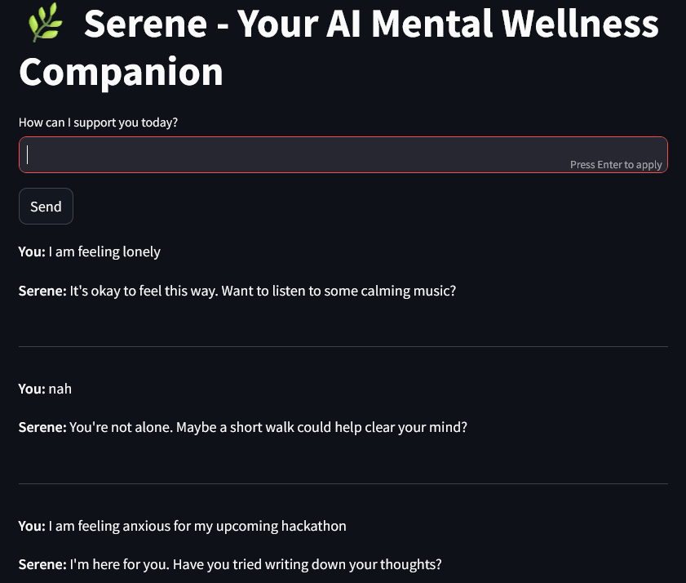
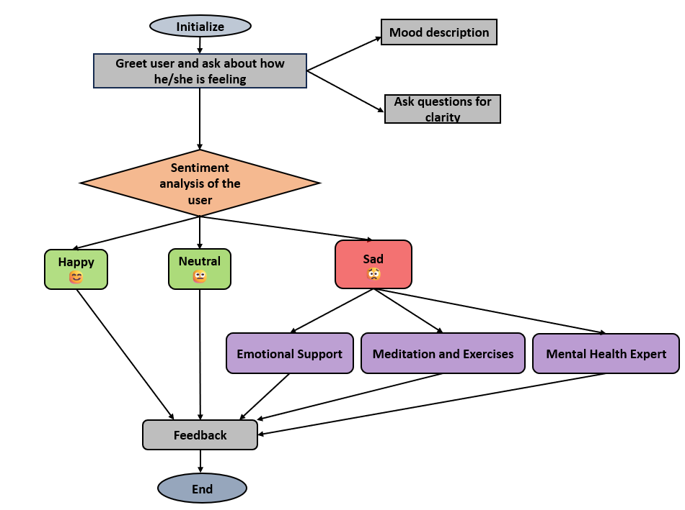
TECHNICAL APPROACH
Tech Stack:
Frontend(Streamlit), Backend(Python), AI Model (FLAN-T5), Sentiment Analysis(HF Transformers Pipeline), API
Implementation Process:
Environment setup -> Implementation of sentiment analysis -> building chatbot logic and frontend
Visual Representation:
FLOWCHART
WORKING PROTOTYPE

Slide 4
FEASIBILITY & VIABILITY
Feasibility:
Using pre-built models(From Hugging Face) and ready-to-use UI(using Streamlit) the solution can be implemented while reducing the development time.
Challenges:
Delays in responses, API rate limits, user engagement, limited personalization, AI misguidance etc.
Strategic Solutions:
Optimizing prompt length, voice based interactions, music based on user mood, storing histories of user interactions, daily check-in system, and to avoid misguidance by combining human verified mental health guidelines with AI insights, providing disclaimer and professional help suggestion.

